Slide 1
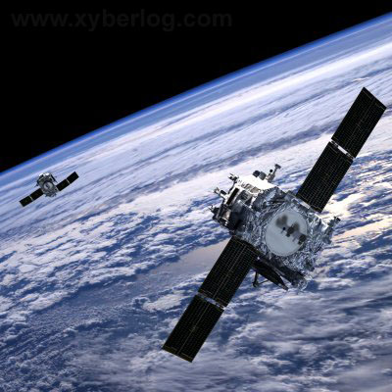
SATELLITE MOTION

Slide 2
Satellites
-Continuously falls towards the earth.
-Are launched to a position above the earths surface to avoid air resistance.
-Escape speed is 11.2 km/s for earth.
-Orbital velocity depends on orbital radius, the function of the satellite and the value of ‘g’ at its orbital radius.

Slide 3
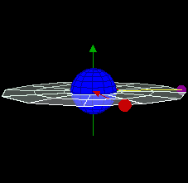
Geosynchronous orbit
What is the period of a satellite in geosynchronous orbit?
One day
Is it moving faster or slower than the earth’s rotation on its axis?
Faster due to its larger radius

Slide 4
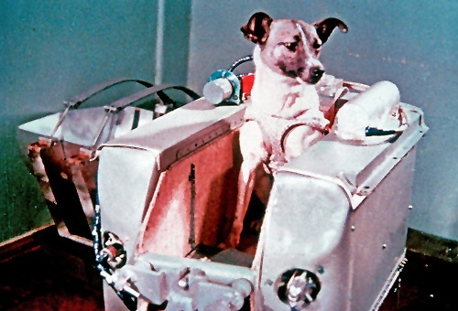
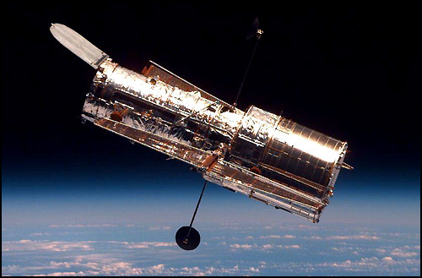
Sputnik was the first satellite to orbit the earth was in October 1957 by the Soviet Union. Sputnik II carried a dog.
Explorer – January 1958 first US satellite.
Hubble Telescope- 1990-pres
-Revolves every 97 minutes
-Fast enough to travel across the United States in about 10 minutes.

Slide 5
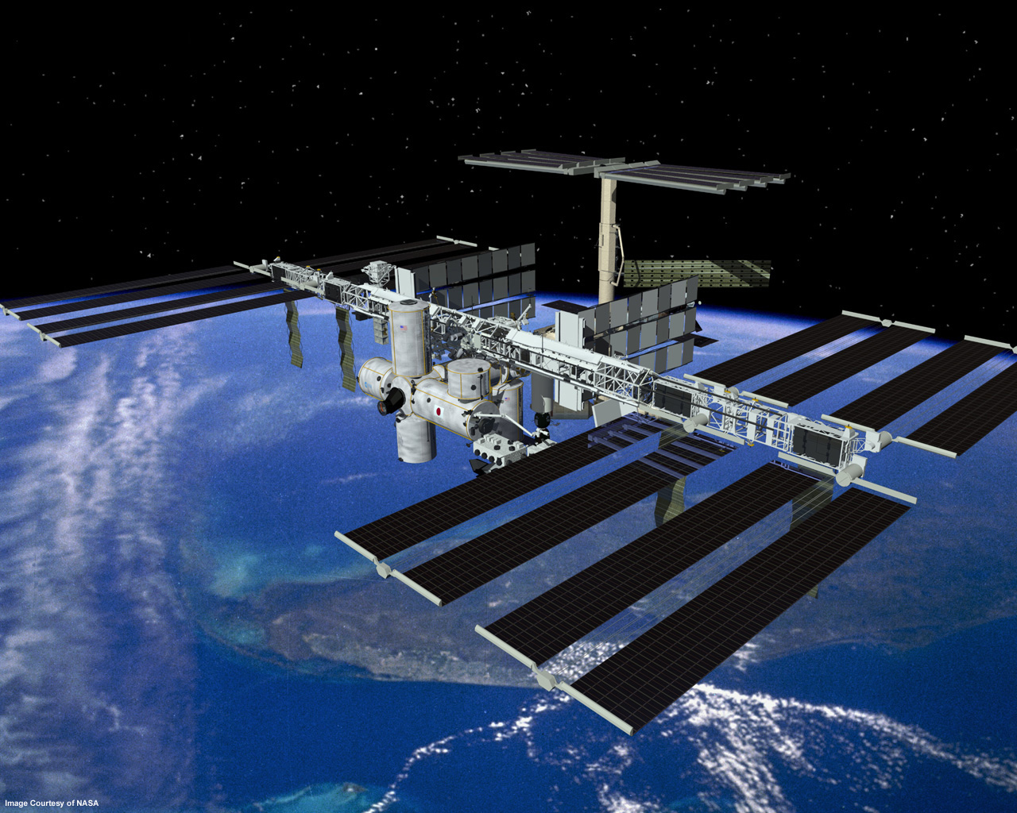
International Space Station
Construction 1998-2011 The station can be seen from the Earth with the naked eye, and is the largest artificial satellite orbiting the Earth.

Slide 6
-1 NATURAL SATELLITE, -2271MANUFACTURED (not all are functioning 82 launched in 2016) 23,000 SPACE JUNK

Slide 7
Uses: -Communications- 713 satellites -Earth observation/science-374 satellites -Technology Demonstration/Development- 160 -Navigation & Global Position- 105 satellites -Space Science- 67 satellites - Only 1,419 are operational satellites

Slide 8
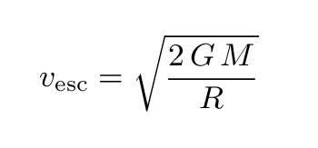
Escape Speed- speed needed to leave a planets gravitational field
V =m/s G= 6.67 x 10⁻¹¹ Nm²/kg²
M=mass of planet R= radius of planet

Slide 9
A probe that has been on the moon needs to be brought back to earth. What escape speed does it need to leave the surface of the moon?
v = 2(6.67x 10⁻¹¹ )(7.35 x 10²²kg)
1.74 x 10⁶m
v = 2373.8m/s
√

Slide 10
Orbital Speed- speed needed to keep the satellite in orbit
V _{orbit} = √g R_{orbit}
V= m/s R- orbital radius=m
g= acceleration due to gravity (m/s²)

Slide 11
The Hubble telescope orbits the earth with an orbital radius of 7.4 x10⁶m. If it experiences a gravitational acceleration of 8.65m/s² due to the earth, what is its orbital velocity?
V_{orbit} = √ gR_{orbit}
V= √8.65m/s² (7.4 x10⁶m)
V= 8000m/s

Slide 12
Orbital Period- time for one revolution of a satellite
T ₌ Time
# of trips
Frequency of orbit:
f= 1/T

Slide 13
The period of the Hubble telescope is 97minutes. Calculate its frequency?
f=1/T
f = 1/5820sec = .000172 rev/sec

Slide 14
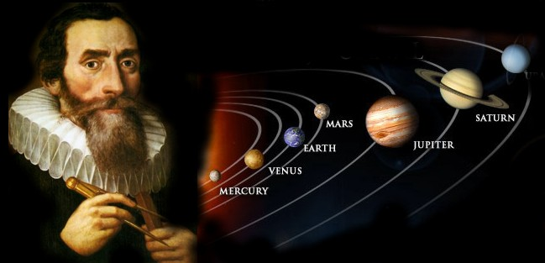
Geosynchronous Orbit- Satellite is in one position above the earth. Time for satellite to orbit is 24 hrs.
Is it moving faster or slower than the earth?

Slide 15
Johannes Kepler
Johannes Kepler was born on December 27, 1571, in Germany.
First to correctly explain planetary motion, and developed the planetary laws.
First to explain that the tides are caused by the Moon orbiting the Earth.
He coined the word "satellite"

Slide 16
Kepler’s First Law
The planets orbit the sun in an elliptical path with the sun located at one foci.
The apogee is the point farthest from the sun.
The perigee is the position closest to the sun
Pluto’s path is most elliptical and Venus is the most circular.

Slide 17
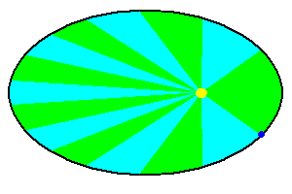
Kepler’s Second Law
The planet sweeps out equal area’s over equal amounts of time.
Where is its velocity the greatest?
Where is PE and KE greatest?

Slide 18
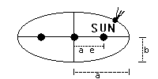
Kepler’s Third law
The square of a planet’s period, T², is directly proportional to the cube of its semi-major axis ( a³) in Astronomical units (AU).
1 AU = average distance between Earth and Sun (93,000,000 miles)
Period—the time it takes for the planet to go around the Sun (i.e., the planet’s year)
T² = a³

Slide 19
PLANET | ORBITAL PERIOD (In Earth years) | DISTANCE FROM SUN (in AU)
MERCURY | .24 | .39
VENUS | .62 | .72
EARTH | 1 | 1
MARS | 1.88 | 1.52
JUPITER | 11.86 | 5.2
SATURN | 29.46 | 9.54
URANUS | 84.01 | 19.18
NEPTUNE | 164.8 | 30.06
PLUTO | 285.4 | 39.44
AU-astronomical units- mean distance
from the sun to the Earth

